Slide 1
School Supply Drive
2024 SUPPLY DRIVE COORDINATOR TOOLKIT

Slide 2
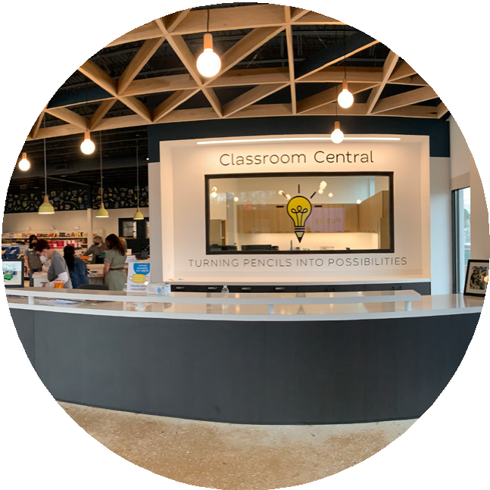
About
About Classroom Central
Classroom Central fosters equity in education by providing teachers and students with the free resources they need to succeed. We serve teachers and students in nearly 250 schools across six regional school districts. We distribute supplies through our Free Store, Mobile Free Store, Curbside Pick-Up, Subscription Service and several other community-supported initiatives. Since opening our doors in 2002, Classroom Central has distributed over $85 million worth of free school supplies. Learn more at ClassroomCentral.org
School Supply Drive
Thank you for hosting a school supply drive campaign! Classroom Central is proud to partner with the community to host school supply drives and equip students in need.
9 Supplies Most Needed
Pencils
Crayons
Colored Markers
Highlighters
Dry Erase Markers
Composition Books
Filler Paper
One Subject Notebooks
Pocket Folders
Why: 1 in 2 local students come to school empty-handed. Our students need over 1,000,000 school supplies.
Who can participate: We invite everyone to join — individuals, businesses, faith groups, civic groups, neighborhoods, sports teams, etc.
When: You can donate or choose your drive dates anytime.
Where: Host an in person drive at your location of choice. Your support will help prepare 162,000 students and their teachers in our region for the upcoming school year.
Host a traditional drive and/or host a virtual drive!
Have questions or need help? Contact Darden Blow
at darden@classroomcentral.org or 704.377.1740 ext. 4120

Slide 3
Recruit a small committee
Committee members can share the workload by helping with the following tasks:
Make and distribute flyers or posters.
Send emails to their network.
Post on social media.
Count and sort the supplies at the end of your drive.
Deliver the supplies after they’re counted.
Host a
Traditional Drive
Choose your drive dates
Pick any length of time to host your drive and take advantage of the best back-to-school sales.
Decide what / how you want to collect
Check out the list of top 9 school supplies on the previous page and decide what you want to collect. You may want to focus on one particular supply or a group of supplies (coloring items, paper products, etc.) rather than all nine.
Have fun & get creative
Make your drop-off box/barrel noticeable! Put a colorful box/barrel with information about your drive in a place where people can see it and easily drop off their items.
Starting a competition between departments, floors, businesses next door, or competing businesses can really boost results —especially when incentives are involved. Set a goal for each “team,” or an overall goal for the drive —and tell people about it.
Spread the word & build excitement
Have a kick-off event, share school supply sales info, provide visual updates (like a thermometer) and engage participants via various communication channels.
Tell them why donating school supplies matters!
Count items & prep for delivery
Schedule your donation drop-off appointment at Classroom Central.
Complete your sorting sheet & drop off donations
Pack your supplies in boxes (copy paper boxes preferred) for easy delivery.
Have questions or need help? Contact Darden Blow
at darden@classroomcentral.org or 704.377.1740 ext. 4120

Slide 4
Donate
Financially
Monetary Donations
Checks or Cash:
Include your organization name in the memo line. Checks or cash can be made payable to Classroom Central and mailed to
2116 Wilkinson Blvd., Charlotte, NC 28208.
Credit Cards:
Make credit card donations online via our website at ClassroomCentral.org.
To ensure donations are credited to your company’s supply drive total, please type “School Supply Drive Name” along with your name, company name and/or supply drive location in the “Share your comments” box.
Matching Gifts
If your company has a matching gift program — make sure to remind your employees to complete the necessary paperwork.
If you’re hosting a virtual supply drive, encourage your donors to look for the checkbox during the donation process that states, “This donation can be matched.”
Classroom Central turns every $1 donated
into $9 worth of school supplies for a student in need.
Have questions or need help? Contact Darden Blow
at darden@classroomcentral.org or 704.377.1740 ext. 4120

Slide 5
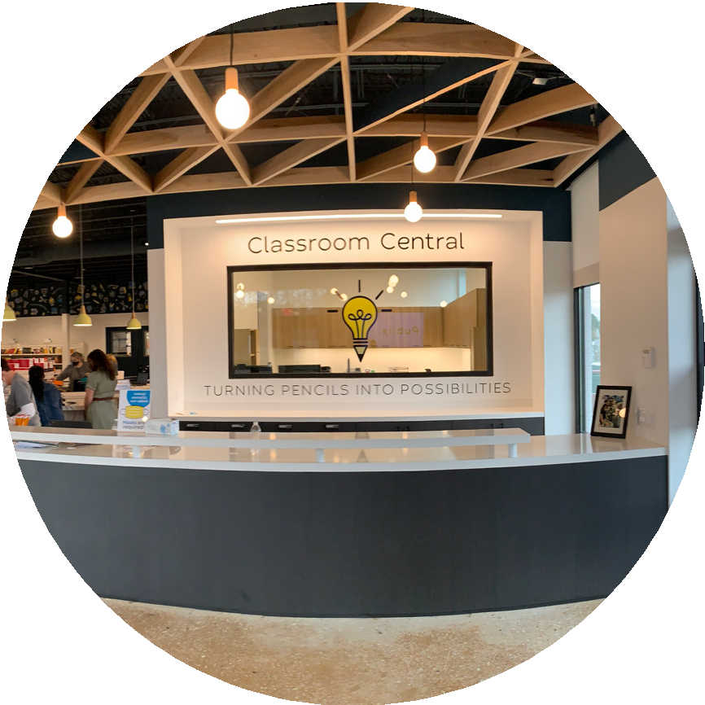
Marketing
& Resources
Sample
To help you spread the word to your network
Sorting Sheet:
With point information
Classroom Central Fly
An overview of Classroom Central what we do
Classroom Central Video:
To show others how you’ll make an impact
Classroom Central Stats & Impact: Info from our annual teacher survey
Local School Supply Sales: Weekly updates of sales at major retailers
Work smarter,
not harder! We have several items for you to use when telling people about your supply drive and involvement in the
9 School Tools campaign.
These resources and more can be found on ClassroomCentral.org/9schooltools,
as well as the Resources tab of your
virtual supply drive fundraising dashboard.
Directions to Classroom Central
Once your supply drive is complete, please schedule your delivery appointment with Darden.
Classroom Central
2116 Wilkinson Boulevard
Charlotte, NC 28208
When you arrive, please drive around to the back of the building and we will help you unload your school supplies at our loading dock.
Have questions or need help? Contact Darden Blow
at darden@classroomcentral.org or 704.377.1740 ext. 4120

Slide 6
Sample Emails
We hope these sample emails will help you promote your school supply drive.
Feel free to get creative and remember to customize the items in italcs to your drive & organization. If you’d like the hyperlinks to remain intact, please be careful when re-formatting or copying and pasting the text.
Email 1: Announce your drive
(We recommend sending one week before your drive starts.)
Did you know that 54% of children in our community live below the poverty line and can’t afford the basic school supplies they need to learn. That means 1 in every two local students comes to school empty-handed.
That’s why we’re partnering with Classroom Central to make sure all local students are equipped to succeed in school. Classroom Central serves more than 162,000 students and their teachers across 6 school districts in nearly 250 high-need schools. Their mission is to equip students to effectively learn by collecting and distributing free school supplies to their teachers.
Equipping all local students with all of the basic tools they need to succeed will require over 1,000,000 supplies. So, we need everyone’s help!
We will be hosting a school supply drive to benefit Classroom Central. Our goal is to collect [insert your goal] supplies. Our supply drive will run [insert dates].
[For traditional drives, insert logistics such as where barrels are located, etc. For virtual drives, include a link to your virtual supply drive page.]
Your support is more crucial this year than ever before. Every November, we receive updated statistics on free/reduced lunch for the schools we cater to. Typically, there are a few schools that become eligible due to changes in student populations. However, this year is different. We have welcomed 34 newly eligible schools, and what’s even more significant is the addition of 38,000 students who are relying on our support. This marks the largest increase in our 20-year history, with several schools that have never qualified or required our assistance before. To ensure we can adequately meet the needs of these additional students without compromising our impact on those already being served, we must obtain more essential supplies like paper and pencils, which are crucial for both students for both students and teachers.
Have questions or need help? Contact Darden Blow
at darden@classroomcentral.org or 704.377.1740 ext. 4120

Slide 7
Sample Emails
We hope these sample emails will help you promote your school supply drive.
Feel free to get creative and remember to customize the items in italcs to your drive & organization. If you’d like the hyperlinks to remain intact, please be careful when re-formatting or copying and pasting the text.
Email 2: Kickoff Day
(Including the previous email for reference may be helpful.)
Today is the first day of our school supply drive! Remember: [Insert a reminder about goal, logistics for traditional supply drives about where to drop off their items, a link to your virtual supply drive, campaign timeline, any incentives/contests, or any other things you want them to know about your specific campaign.]
Classroom Central also accepts financial contributions, and they’re 100% tax-deductible. Classroom Central transforms each dollar donated into $9 worth of school supplies for a student in need!
To put the impact you’re making into perspective, Ms. Matthews, a Charlotte-Mecklenburg Schools teacher says it best, “Thank you never seems like enough! My scholars depend on wipes, pencils, paper, markers, pens, and book bags — which they need because the ones they have are tearing apart. On behalf of my 3rd grade students at Sugar Creek Charter School and the educators all over, thank you for your donations to our scholars who need everything you give so generously.”
If you’d like to volunteer to help us sort and count our donations at the end of our drive, please contact
[insert contact information].
This year, your support is exceptionally vital. With approximately 38,000 new students relying on us, your supply and monetary donations enable us to assist all eligible schools and students without diminishing our current impact. You can make all the difference for the 1 in every two local students who lack the necessary supplies to keep up with their peers and learn new lessons.
Have questions or need help? Contact Darden Blow
at darden@classroomcentral.org or 704.377.1740 ext. 4120

Slide 8
Sample Emails
We hope these sample emails will help you promote your school supply drive.
Feel free to get creative and remember to customize the items in italcs to your drive & organization. If you’d like the hyperlinks to remain intact, please be careful when re-formatting or copying and pasting the text.
“
Email 3: Reminder & Educator Story
It’s [insert week/day #] of our school supply drive! The deadline for donations is [insert deadline]!
Consider this insight from Dr. Regina Boyd, Principal of University Park Creative Arts Elementary: “You have to remember our students that are now in second grade, this is their first time in the school building. So they were not in the building for kindergarten or first grade. They're walking
through the door for the first time as a second grader and not having those foundational skills. So now teachers are getting students that have experienced learning loss. But their expectations are still high, right? They're still great teachers.
But now they're working with grade level curriculum, as well as trying to fill in some things that maybe scholars did not master fully on a Zoom screen because it just wasn't that high level of engagement.
Everybody's kitchen table was not
equal. So we were trying to create
some equity amongst what the
students had in terms of their tools for learning. We sent home crayons, notebooks, rulers. You name it. Glue, scissors. Now that we're back in the school, we still send the supplies home for them to do homework.
We've learned that if we supply some of those materials at home, the work product comes back in a manner that
we want it to for success.
— Dr. Boyd, Charlotte-Mecklenburg Schools
Everybody's kitchen table was not equal. So we were trying to create some equity amongst what the students had in terms of their tools for learning. We sent home crayons, notebooks, rulers. You name it. Glue, scissors. So that they could participate and actually engage in learning and not just be looking at a Zoom screen, but actually do some of the work that they would've done in the classroom.
Now that we're back in the school, we still send the supplies home for them to do homework. We've learned that if we supply some of those materials at home, the work product comes back in a manner that we want it to for success. It's just been a great partnership with Classroom Central to help us fill in a gap so that I can give students what they need, send home what we need for parents, and most importantly, for me, redirect funds in a different way.
[For traditional drives, insert link to local school supply sales. For virtual drives, insert a link to your page.]

Slide 9
Sample Emails
We hope these sample emails will help you promote your school supply drive.
Feel free to get creative and remember to customize the items in italcs to your drive & organization. If you’d like the hyperlinks to remain intact, please be careful when re-formatting or copying and pasting the text.
“
Email 4: Reminder & Student Story
I had a student recently join my class.
All she came to class with was an
It’s [insert week/day #] of our school supply drive! The deadline for donations is [insert deadline]!
empty book bag. When other students
began to take out their materials, she was ashamed because she didn’t have anything. I grabbed a zipper pouch filled with crayons, pencils, glue and scissors from Classroom Central and no one thought anything of it. The little girl looked as though she had won the lottery. The materials I receive from Classroom Central have been a life saver on more than one occasion.
— Ms. Bass, Lancaster County (SC) Schools
I’d like to to introduce you to Ms. Bass and her new student: “I had a student recently join my class. All she came to class with was an empty book bag. When other students began to take out their materials, she was ashamed because she didn’t have anything. I grabbed a zipper pouch filled with crayons, pencils, glue
and scissors from Classroom Central and no one thought anything of it. The little girl looked as though she had won the lottery. The materials I receive from Classroom Central have been a life saver on more than one occasion. — Ms. Bass, Lancaster County (SC) Schools
[For traditional drives, insert a link to local school supply sales. For virtual drives, insert a link to your page.]
Have questions or need help? Contact Darden Blow
at darden@classroomcentral.org or 704.377.1740 ext. 4120

Slide 10
Sample Emails
We hope these sample emails will help you promote your school supply drive.
Feel free to get creative and remember to customize the items in italcs to your drive & organization. If you’d like the hyperlinks to remain intact, please be careful when re-formatting or copying and pasting the text.
Email 5: Reminder & Teacher Testimonials
It’s [insert week/day #] of our school supply drive! The deadline for donations is [insert deadline]!
See what teachers have to say about us — Classroom Central’s donors:
“Students are often embarrassed to admit that they do not have the required supplies. Your generosity has granted so many children more self-confidence and capability to complete school work and fulfill their dreams.”
“You guys have given me more than I could ever repay you for. I am constantly spending $1,500-$2,000 each school year on my students and supplies. With your generosity, more of my money has been able to go towards my needs while also allowing my students to have access to what they need and deserve in their educational enviroment.”
“Without you all, my life would be a lot more difficult and costly!”
“Classroom Central brings equity into my classroom, by enabling all students to be prepared and ready to learn.”
"Please share with your donors and let them know YOU ARE ALL DIFFERENCE MAKERS!"
Here’s how to donate: [For traditional drives, add details and insert a link to local school supply sales. For virtual drives, insert a link to your page.]
Remember, your support is crucial this year to help support the 38,000 newly eligible students in our districts. As our community expands, the demand in our region keeps rising, and Classroom Central relies on your support to ensure our eligible teachers and students can consistently depend on us.
Have questions or need help? Contact Darden Blow
at darden@classroomcentral.org or 704.377.1740 ext. 4120

Slide 11
Sample Emails
We hope these sample emails will help you promote your school supply drive.
Feel free to get creative and remember to customize the items in italcs to your drive & organization. If you’d like the hyperlinks to remain intact, please be careful when re-formatting or copying and pasting the text.
Bonus Email: Partner & Vendor Email Template
One of the reasons we appreciate our partnership is because we share similar values behind our missions. As an organization, we value education and creating equity in our community. That’s why [company name] is supporting Classroom Central, a nonprofit that serves and provides free school supplies to 162,000 local students.
Our partnership is valuable to us because of the work we accomplish and because education and promoting equity in our community are principles that both our organizations hold dear. This is why [company name] supports Classroom Central, a nonprofit that serves area teachers and students, fostering equity in the classroom by providing the free resources they need to succeed.
This summer, we're PROUDLY hosting a 9 School Tools supply drive to collect the highest quantities of the nine most needed school supplies for students. In our community, more than 54% of children live below the poverty line and can't afford the basic school supplies they need to participate actively in the classroom this fall. That means one in every two local students comes to school empty-handed.
Will you join us in support of Classroom Central by donating? [For traditional drives, add details. For online drives, insert a link to your page.] You can create a fundraising team for our company's online supply drive. [insert link]
Your support is more crucial than ever this year to help support the 38,000 newly eligible students in our districts. As our community expands, the demand in our region keeps rising, and Classroom Central relies on your support to ensure our eligible teachers and students can consistently depend on us.
Please consider donating to our fundraiser today: [insert link]
Thank you for your support and our continued partnership!
Have questions or need help? Contact Darden Blow
at darden@classroomcentral.org or 704.377.1740 ext. 4120

Slide 12
Sample Emails
We hope these sample emails will help you promote your school supply drive.
Feel free to get creative and remember to customize the items in italcs to your drive & organization. If you’d like the hyperlinks to remain intact, please be careful when re-formatting or copying and pasting the text.
Email 6: Wrap up & Thank you
Thank you for your support of our school supply drive! We were able to collect [insert final counts] school supplies to help students and teachers across our community and benefit Classroom Central.
[Insert reminder about goal, any incentives/contest winners and any other items you want them to know about your drive.]
If you enjoyed this event and would like to learn more about Classroom Central, check out their remote or in-person volunteer opportunities. Attend a monthly Show & Tell event.
Thank you for your support and making this a successful school supply drive!
Have questions or need help? Contact Darden Blow
at darden@classroomcentral.org or 704.377.1740 ext. 4120

Slide 13
Sample Social Posts
An easy way to promote your supply drive is to share/retweet/repost content from Classroom Central’s pages! You can also use the captions below or feel free to create your own.
Remember to customize the items in italics to your drive and organization. Reference your resources for available social media graphics and imagery.
Announcing your drive
Facebook & Instagram Captions:
54% of children in our community live below the poverty line and can’t afford the basic school supplies they need to learn. That means 1 in every 2 local students comes to school empty-handed. That’s why we’re hosting a school supply drive for @ClassroomCentral to make sure students are equipped to overcome pandemic learning loss. [Insert your school supply drive location or your virtual supply drive link]
Twitter Caption:
We’re hosting a school supply drive for @ClassrmCentral to equip students in need and foster equity in education. Will you join us? [Insert your school supply drive location or your virtual supply drive link]
Promoting your drive
Facebook & Instagram Caption:
Did you know @ClassroomCentral provides FREE school supplies to local teachers all year? Donate supplies today to help ensure every teacher has the supplies they need and every student has an opportunity to succeed. [Insert your school supply drive location or your virtual supply drive link] *apple emoji* *pencil emoji*
Twitter Caption:
@ClassrmCentral provides FREE school supplies to local teachers all year! Donate supplies to ensure every teacher has the supplies they need and every student has an opportunity to succeed. [Insert your school supply drive location or your virtual supply drive link] *apple emoji* *pencil emoji*
Have questions or need help? Contact Darden Blow
at darden@classroomcentral.org or 704.377.1740 ext. 4120

Slide 14
Sample Social Posts
An easy way to promote your supply drive is to share/retweet/repost content from Classroom Central’s pages! You can also use the captions below or feel free to create your own.
Remember to customize the items in italics to your drive and organization. Reference your resources for available social media graphics and imagery.
Promoting your drive continued
Facebook & Instagram Captions:
71% of economically disadvantaged students failed NC state exams. Help us ensure every student has the supplies they need to overcome pandemic learning loss. Donate to our supply drive for @ClassroomCentral! [Insert your school supply drive location or your virtual supply drive link]
This upcoming school year is a crucial opportunity to overcome pandemic learning loss. You can make all the difference for a student in need by supporting our supply drive for @ClassroomCentral! [Insert your school supply drive location or your virtual supply drive link]
54% of CMS students live below the poverty line, which means 1 in every 2 students will be unequipped to overcome pandemic learning loss, let alone learn new lessons. But you can make all the difference for a student in need by supporting our supply drive for @ClassroomCentral! [Insert your school supply drive location or your virtual supply drive link]
Equal opportunities in education can change the trajectory of lives, but this school year, students’ needs will be greater than ever. Help level the playing field by donating school supplies for @ClassroomCentral at [physical location or virtual drive link]
Help prepare local students for school by donating school supplies for @ClassroomCentral! [Insert your school supply drive location or your virtual supply drive link]
Donate school supplies at [physical location or virtual drive link] for our @ClassroomCentral drive between[drive dates] to help local students succeed! #9SchoolTools *pencil emoji* *composition notebook emoji* *pencil on paper emoji*
@ClassroomCentral serves over 127,000 students and their teachers across 6 school districts, and equipping all local students with all the basic tools they need to succeed will require over 1,000,000 supplies. So we need everyone’s help! [Insert your school supply drive location or virtual supply drive link]
Have questions or need help? Contact Darden Blow at darden@classroomcentral.org or 970-331-6168

Slide 15
Sample Social Posts
An easy way to promote your supply drive is to share/retweet/repost content from Classroom Central’s pages! You can also use the captions below or feel free to create your own.
Remember to customize the items in italics to your drive and organization. Reference your resources for available social media graphics and imagery.
Promoting your drive continued
Twitter Captions:
This upcoming school year is a crucial opportunity to overcome pandemic learning loss. You can make all the difference for a student in need by supporting our supply drive for @ClassrmCentral! [Insert your school supply drive location or your virtual supply drive link]
Equal opportunities in education can change the trajectory of lives, but this school year, students’ needs will be greater than ever. Help level the playing field by donating school supplies for @ClassrmCentral at [physical location or virtual drive link]
Help prepare local students for school by donating school supplies for @ClassrmCentral! [Insert your school supply drive location or your virtual supply drive link]
Donate school supplies at [physical location or virtual drive link] for our @ClassrmCentral drive between [drive dates] to help local students succeed! #9SchoolTools *pencil emoji* *composition notebook emoji* *pencil on paper emoji*
Wrapping up & thanking your donors
Facebook & Instagram Caption:
Thank you! We appreciate everyone who donated to our #9SchoolTools supply drive benefitting
@ClassroomCentral! With your support, students in need will have over [# supplies collected]!
Twitter Caption:
Thank you! We appreciate everyone who donated to our #9SchoolTools supply drive benefitting @ClassrmCentral! With your support, over [# supplies collected] school supplies will be distributed to local teachers and students this school year! *pencil emoji* *apple emoji*
Have questions or need help? Contact Darden Blow
at darden@classroomcentral.org or 704.377.1740 ext. 4120

